Slide 1
ECEN 214, Spring 2022 Electrical Circuit Theory
Class 2: Power and Sources
Prof. Adam Birchfield
Dept. of Electrical and Computer Engineering
Texas A&M University
abirchfield@tamu.edu

Slide 2
A Bigger Example
Write out Ohm's law for each resistor and KCL and KVL everywhere in the circuit that might be useful and see if you can get a set of equations to solve for $V_{1}, V_{2}, V_{3},I_{1}, I_{2}, I_{3}$
$$I_{1}$$
+
_
$$V_{1}$$
$$I_{2}$$
+
_
$$1 Ω$$
$$V_{2}$$
$$I_{s}$$
_
+
$$2 Ω$$
$$1 A$$
$$I_{3}$$
$$3 V$$
_
+
$$15 V$$
+
_
$$5 A$$
$$V_{3}$$
$$3 Ω$$
Bonus: what's the voltage across the 5 A current source?

Slide 3
A Bigger Example
Write out Ohm's law for each resistor and KCL and KVL everywhere in the circuit that might be useful and see if you can get a set of equations to solve for $V_{1}, V_{2}, V_{3},I_{1}, I_{2}, I_{3}$
Solution:
Ohm's law
$V_{1}=I_{1}$
$V_{2}=2I_{2}$
$V_{3}=3I_{3}$
KCL
$5−1=I_{1}$
$1=I_{s}+I_{3}$
$I_{1}+I_{s}=I_{2}$
KVL
$V_{3}+3−V_{2}−15=0$
$I_{1}=4 A$; $V_{1}=4 V$
$I_{s}=1−I_{3}$
$4+1−I_{3}=I_{2}$
$3I_{3}+3−2I_{2}−15=0$
$$3I_{3}+3−2\left(5−I_{3}\right)−15=0$$
$I_{3}=4.4 A$; $V_{3}=13.2 V$
$I_{2}=0.6 A$; $V_{2}=1.2 V$
$I_{s}=−3.4 A$
$$I_{1}$$
+
_
$$V_{1}$$
$$I_{2}$$
+
_
$$1 Ω$$
$$V_{2}$$
$$I_{s}$$
_
+
$$2 Ω$$
$$1 A$$
$$I_{3}$$
$$3 V$$
_
+
$$15 V$$
+
_
$$5 A$$
$$V_{3}$$
$$3 Ω$$
Bonus: what's the voltage across the 5 A current source?

Slide 4
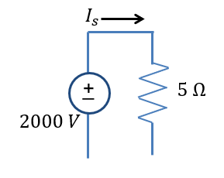
Short Circuit and Open Circuit
The voltage across a short circuit is zero
The current through an open circuit is zero
+
V
_
$$6mA$$
$$16kΩ$$

Slide 5
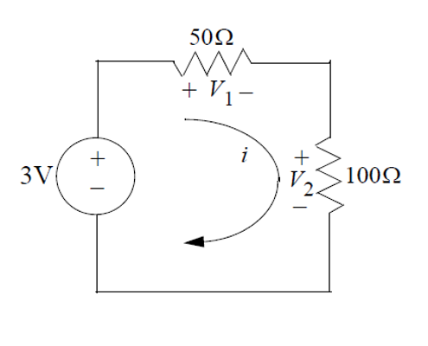
Example of Series Devices
Elements in series share one junction, with nothing else connected to the same junction
They have the same current (KCL)
Resistors in series add
For the circuit shown:
Find the current flowing through the circuit.
Find the voltage across each resistor.
Notes:
=+IV

Slide 6
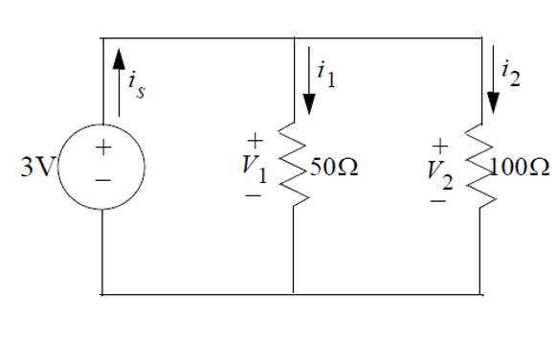
Example of Parallel Devices
Elements in parallel share two junctions, regardless of what else is connected
They have the same voltage (KVL)
Resistors in parallel combine as: $R_{∥}=\frac{1}{\frac{1}{R_{1}}+\frac{1}{R_{2}}}$
For the circuit shown:
Find the voltage drops across each resistor.
Find the currents flowing through each resistor.
Find the current flowing through the voltage source.
Notes:
=+IV

Slide 7
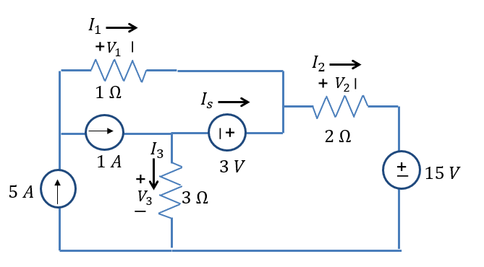
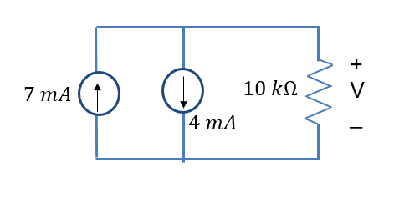
Examples: Find Shorts, Opens, Parallel, Series
$$1 V$$
$$I_{s}$$
$$1 V$$
_
$$I_{s}$$
+
_
+
+
V
_
_
$$30 Ω$$
+
V
_
$$10 V$$
+
$$30 Ω$$
_
$$10 V$$
+

Slide 8
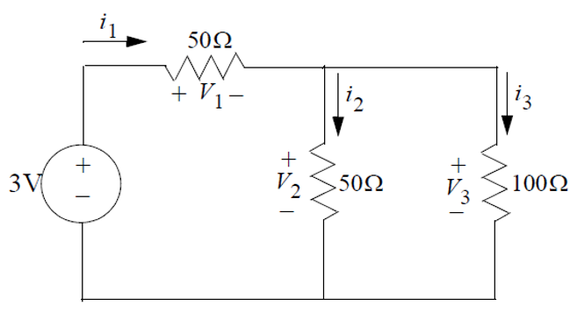
Another Practice Example of KCL and KVL
For the circuit shown, find all voltages and currents for the three resistors.
Notes:
=+IV

Slide 9
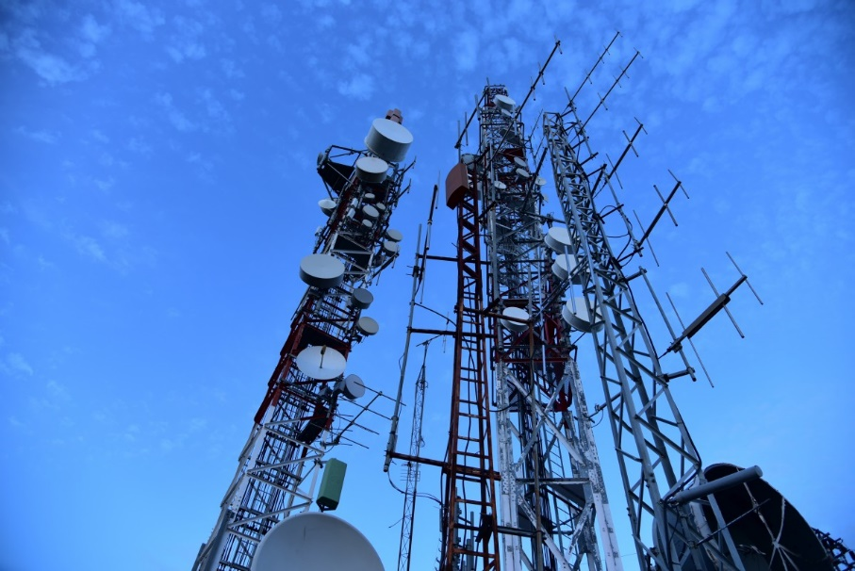
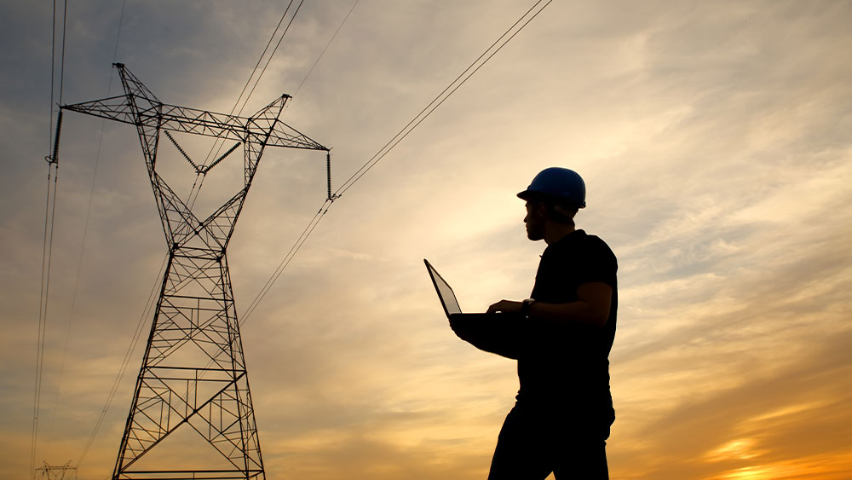
Electrical Engineering Has Changed the World
Two main functions of engineering
Analysis – break it down
Design – build it up
What's electricity useful for?
Transmitting energy – the ability to do useful work
Transmitting information – data with meaning
What makes electricity especially good for that?
It is fast – we can send vast amounts of energy and information at nearly the speed of light across continents (and information across oceans and space)
It is efficient – very little energy losses in conductors, information can be processed in nano-sized devices

Slide 10
Electrical Power
Definition: Power is the rate of energy (work) expended per unit time.
$$P=\frac{dw}{dt}$$
P=power (Watts) 1 Watt =$\frac{\text{1 }\text{Joule}}{\text{1 }\text{second}}$
t=time (seconds)
w=work or energy (Joules)
Note also that
$$P=\frac{dw}{dt}=\frac{dw}{dq}∙\frac{dq}{dt}=v∙i$$
1 Watt = (1 volt)(1 amp)
Calculate the power produced by the source and absorbed by the resistor.
(40 mW)
+
V
_
$$2mA$$
$$10kΩ$$
Sign convention really matters with power! If current flows into the terminal with the plus side of the voltage measurement (like in Ohm's law) the device is absorbing power.

Slide 11
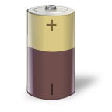
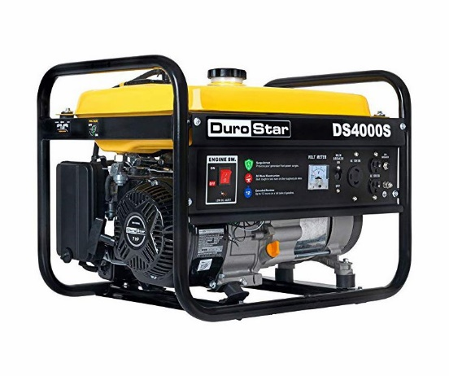
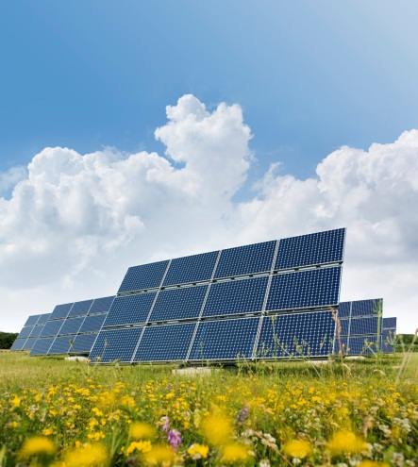
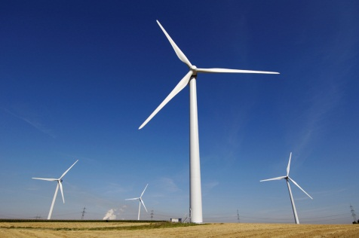
Electrical Sources
Definition: An electrical source is a device capable of converting non-electric energy to electric energy.
Battery – converts chemical to electrical energy
Generator – converts mechanical energy to electrical energy
Wind turbine – converts wind to electrical energy
Solar cell – converts sunlight to electrical energy
Notes:
=+IV

Slide 12
Current Sources
Definition: A current source produces a constant current through its terminals regardless of the voltage across it.
Independent current source – produces the same current regardless of any other voltage/current elsewhere in the circuit.
Voltage controlled current source – produces a current which depends on $V_{x}$, some other voltage elsewhere in the circuit.
$α=$constant of proportionality in amps/volt
Current controlled current source – produces a current which depends on $I_{x}$, some other current elsewhere in the circuit.
$β=$dimensionless constant of proportionality
50mA
$$αV_{x}$$
$$βI_{x}$$
Notes:
=+IV

Slide 13
Voltage Sources
Definition: A voltage source produces a constant voltage across its terminals regardless of the current flowing through it.
Independent voltage source – produces the same voltage regardless of any other voltage/current elsewhere in the circuit.
Voltage controlled voltage source – produces a voltage which depends on $V_{x}$, some other voltage elsewhere in the circuit.
$μ=$dimensionless constant of proportionality
Current controlled voltage source – produces a voltage which depends on $I_{x}$, some other current elsewhere in the circuit.
$ρ=$constant of proportionality in volts/amp
+
_
12V
+
_
$$μV_{x}$$
+
_
$$ρI_{x}$$
Notes:
=+IV

Slide 14
Example of a Dependent Source
Kirchhoff's Current Law
$9+0.1I_{x}−I_{x}=0$
$I_{x}=\frac{9}{0.9}=10 \text{mA}$
$V=10 \text{mA}⋅10 \text{kΩ}=100 V$
Power analysis
Independent voltage source producing (9 mA)(100 V) = 900 mW
Dependent voltage source producing (1 mA) (100 V) = 100 mW
Resistor consuming (10 mA)(100 V) = 1000 mW = 900 mW + 100 mW
This is conservation of energy.
$$I_{x}$$
+
$$V$$
_
$$10 kΩ$$
$$9 mA$$
$$0.1⋅ I_{x}$$

Slide 15
Conservation of Energy
Conservation of Energy:
Total power generated = total power absorbed
Circuit must be isolated from any other devices
Net sum of the power of all elements = 0
Use it to check your work!
Notes:
=+IV

Slide 16
Example 1 of Conservation of Energy
$$I_{2}$$
Circuit
Element 2
_
$$V_{2}$$
+
_
Circuit
Element 1
+
Circuit
Element 3
Circuit
Element 4
+
$$V_{1}$$
$$V_{3}$$
$$V_{4}$$
_
_
+
$$I_{1}$$
$$I_{3}$$
$$I_{4}$$
Element | Voltage | Current
1 | 3 volts | -1mA
2 | -2 volts | -1mA
3 | -1 volt | 4mA
4 | 1 volt | -3mA
Element | Power
1
2
3
4
Total Power = 0
Notes:
=+IV

Slide 17
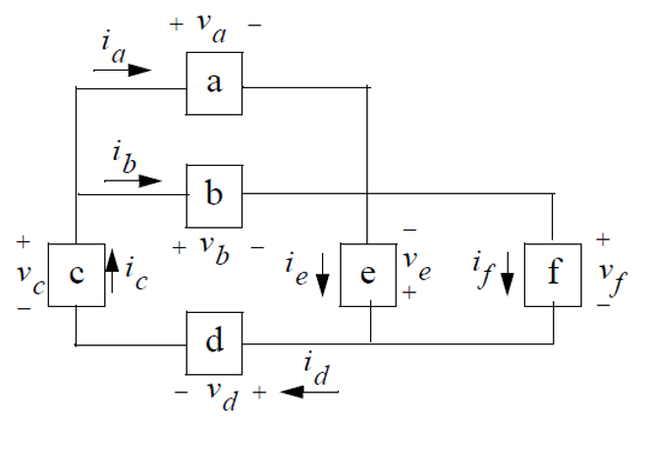
Example 2 of Conservation of Energy
The numerical values for the voltages and currents in the circuit shown are given in the table below. Find the total power developed in the circuit.
Element | Voltage (kV) | Current (mA) | Power (W)
a | 150 | 0.6
b | 150 | -1.4
c | 100 | -0.8
d | 250 | -0.8
e | 300 | -2.0
f | -300 | 1.2
Notes:
=+IV

Slide 18
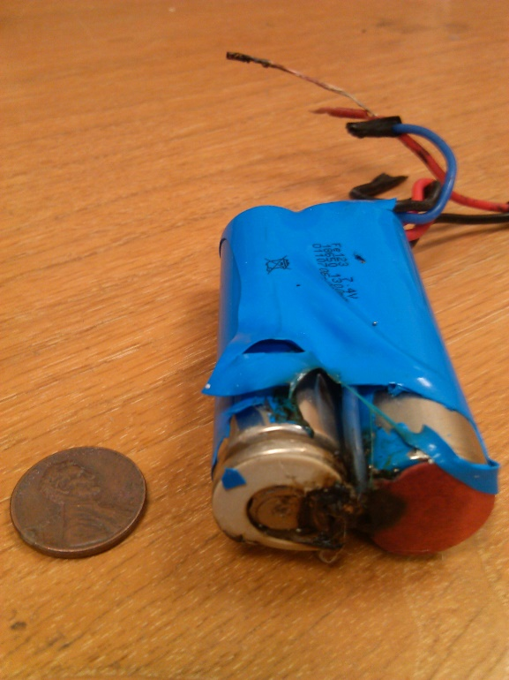
Restrictions on Source Connections
Voltage and current sources cannot be connected in arbitrary manners. The following examples show both valid and invalid connections.
+
+
+
+
_
12V
_
12V
_
12V
_
6V
50mA
50mA
50mA
20mA
+
_
12V
50mA
50mA
50mA
VALID
INVALID
Notes:
=+IV

Slide 19
Restrictions on Source Connections
Here are some more examples of both valid and invalid source connections.
+
+
+
$$V_{x}=3V$$
_
$$3V_{x}$$
$$V_{x}=3V$$
_
_
4$V_{x}$
+
$$I_{x}=2A$$
_
4$I_{x}$
$$I_{x}=2A$$
$$3I_{x}$$
VALID
INVALID
Notes:
=+IV

Slide 20
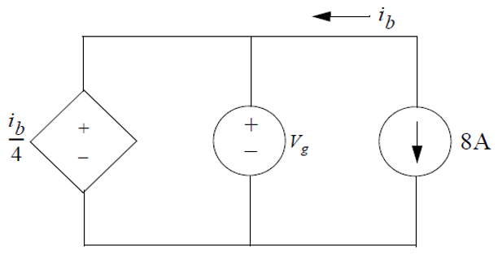
Example of Restrictions on Source Connections
For the circuit shown:
What value of $V_{g}$ is required in order for the interconnection to be valid?
For the value of $V_{g}$ found in part (a), what is the power associated with the 8A current source?
Notes:
=+IV

Slide 21
Assignments
Get the Zybook and complete sections 2.4, 2.6, 2.7, 2.8, 3.2, 3.3, 3.5
Due 4pm on Monday, Jan 31
If you haven’t done the earlier sections that were due today, do these as well
See the syllabus for details on how to get the Zybook
Homework #1 on Canvas
Also due 4pm on Monday, Jan 31
Take it as many times as needed, your best score will count. It is different each time, so it is good for additional practice.
Review in-class examples and notes
Practice, practice, practice!
If the positive/negative conventions are difficult, look through the next 2 slides
Quiz #2 on Wednesday

Slide 22
Passive Sign Convention
Passive Sign Convention - For a two terminal element, whenever the reference direction for the current is in the direction of the voltage drop, use a positive sign in any expression that relates voltage to the current. Otherwise use a negative sign.
In other words, the current should be going into the plus side of the voltage measurement
I
I
+
V
-
+
V
-
Circuit
element
Circuit
element
$V=+IR$ $V=−IR$
$V=+L\frac{dI}{dt}$ $V=−L\frac{dI}{dt}$
$I=+C\frac{dV}{dt}$ $I=−C\frac{dV}{dt}$
$P=+IV$ $P=−IV$
Notes:
=+IV

Slide 23
Test Your Understanding
In this example two circuit elements are connected together. With the voltage polarity and the direction of current defined in the drawing, for each case below determine if Element 1 is delivering power to element 2 or vice versa.
$V=3 \text{volts}$, $I=−20mA,$
$V=−3 \text{volts}$, $I=20mA,$
$V=−3 \text{volts}$, $I=−20mA,$
I
+
V
-
Circuit
Element 1
Circuit
Element 2
Notes:
=+IV

