Slide 1
ECEN 214, Spring 2022 Electrical Circuit Theory
Class 1: Voltage and Current
Prof. Adam Birchfield
Dept. of Electrical and Computer Engineering
Texas A&M University
abirchfield@tamu.edu

Slide 2
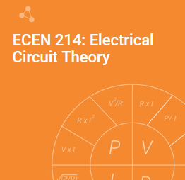
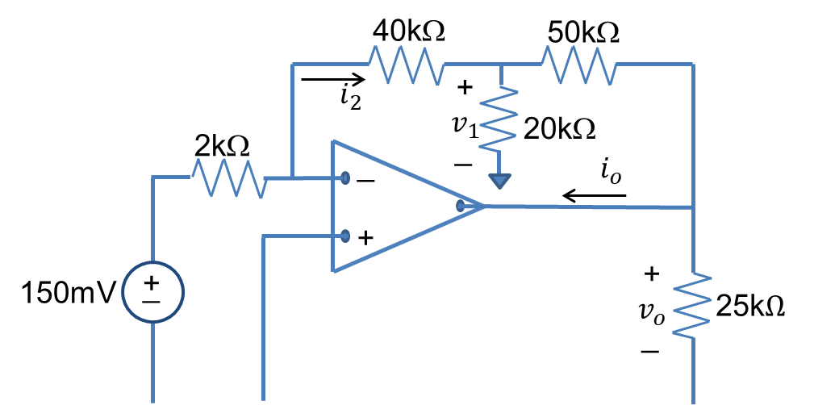
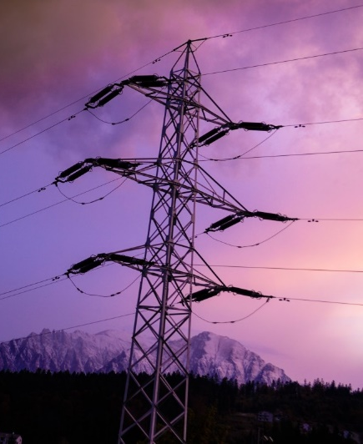
Welcome to ECEN 214!
Goal #1: Become very good friends with electric circuits
Goal #2: Get pumped about being Aggie Electrical Engineers
Goal #3: Learn how to communicate well as an engineer
Syllabus gives more information
Course website: birchfield.engr.tamu.edu/214s22
Zybook online textbook to purchase
30% of grades from preparation, class participation, homework, and quizzes
20% from the lab
50% from 3 hourly exams and final
If you need accommodations for a disability, please let me know as soon as you can.

Slide 3
Examples #1 and #2
Current is measured through an interface
In the first example, the current source is producing 2 mA of current, which then flows across the upper wire, down through the resistor, and back leftward across the lower wire
Voltage is measured between two points
In the second example, the voltage source ensures that the difference between the upper and lower nodes (wires) is 50 V
Independent sources are drawn with a circle. They produce a constant current (arrow) or voltage (plus and minus signs).
Resistors have a linear relationship between its current and voltage, V = IR (known as Ohm's law)
First example: V = (2 mA) (10 k$Ω$) = 20 V
Second example: I = (50 V) / (250 $Ω$) = 0.2 A
+
V
_
$$2mA$$
$$10kΩ$$
$$I_{s}$$
_
$$250 Ω$$
$$50V$$
+

Slide 4
Try a Few Variations (Remember V=IR)
$$2mA$$
+
V
_
+
V
_
+
V
_
$$15kΩ$$
$$10kΩ$$
$$6mA$$
$$16kΩ$$
$$7.5kΩ$$
$$4mA$$
+
V
_
$$20mA$$
$$I_{s}$$
$$50 V$$
$$I_{s}$$
+
$$I_{s}$$
$$I_{s}$$
_
$$250Ω$$
+
$$10kΩ$$
+
$$8 kΩ$$
_
$$5 Ω$$
_
+
$$200 V$$
$$16 V$$
_
$$2000 V$$

Slide 5
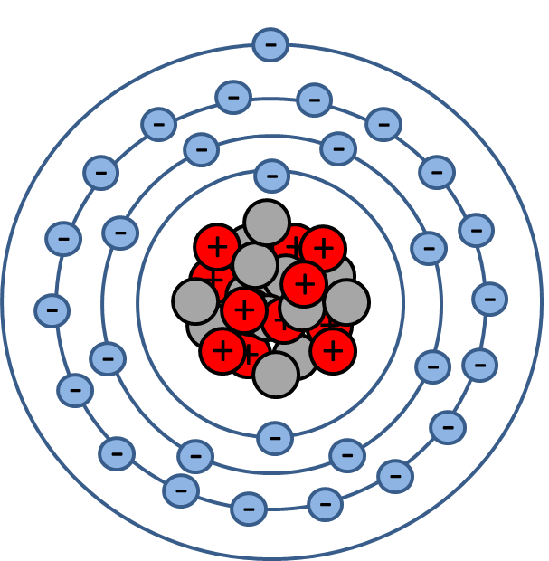
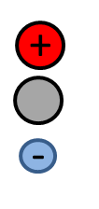
What is Electricity?
Copper atom (Cu)
29 protons (+ charge)
35 Neutrons (neutral charge)
29 electrons (- charge)
Single electron in the outer shell makes it relatively easy to dislodge an electron from the CU atom.
good conductor of electricity
Copper wire

Slide 6
How Do We Make Electrons Move?
Note: The physical flow of electrons (negatively charged current) is moving counterclockwise in this circuit.
Therefore, positively charged current (consisting of positive ions or what we sometimes call “holes”) is flowing clockwise.

Slide 7
Charge
Electric charge is the basis of describing all electrical phenomenon.
Charge is bipolar (it can be positive or negative)
Charge is discrete
Each electron carries a charge of $1.6022×{10}^{−19}$C.
1 Coulomb = $6.24×{10}^{19}$ electrons.
Separation of charge creates an electric force
Voltage (Volts)
Motion of charge creates an electric current
Current (Amps)

Slide 8
Definition of Current
Definition: Electrical current is the rate of flow of charge.
$$I=\frac{dq}{dt}$$
I=current (Amps)
t=time (seconds)
q=charge (Coulombs)
Units of current
1 Amp = $\frac{\text{1 }\text{Coulomb}}{\text{1 }\text{second}}$
= 6.24x1019 electrons/second
$$i(t)$$
Don’t forget – positive current is in the direction opposite of the physical flow of electrons.
$$i(t)$$
$$t$$
$$t$$
Direct current (DC)
Alternating current (AC)

Slide 9
Definition of Voltage
Definition: Voltage is the energy (work) required to move a unit of charge.
$$V=\frac{dw}{dq}$$
V=voltage (volts)
w=work or energy (Joules)
q=charge (Coulombs)
Units of voltage
1 Volt = $\frac{\text{1 }\text{Joule}}{\text{1 }\text{Coulomb}}$
So in a 9V battery, each Coulomb of charge carries 9 Joules of potential energy.
In terms of electrical circuits, we will be concerned with the amount of energy required to move a unit of charge from one terminal of a circuit element to another.
circuit element

Slide 10
Kirchhoff’s Laws
Kirchhoff’s Current Law (KCL): The sum of all currents entering (or leaving) any node of a circuit must be zero.
$I_{S}−I_{1}−I_{2}=0$ (net flow in = 0)
or equivalently
-$I_{S}+I_{1}+I_{2}=0$ (net flow out = 0)
or equivalently
$I_{S}=I_{1}+I_{2}$(flow in = flow out)
$$I_{1}$$
$$I_{2}$$
$$I_{S}$$
$$R_{1}$$
$$R_{2}$$
A Water Analogy: Consider water flowing through a series of pipes. At any junction where multiple pipes intersect, the net flow into the junction must be zero.
Notes:
=+IV

Slide 11
Kirchhoff’s Laws
Kirchhoff’s Voltage Law (KVL): The sum of all voltage drops around any closed loop in a circuit must be zero.
_
+
$$V_{R_{1}}$$
$${−V}_{S}+V_{R_{1}}+V_{R_{2}}=0$$
or equivalently
$$V_{S}=V_{R_{1}}+V_{R_{2}}$$
$$R_{1}$$
+
_
$$V_{S}$$
+
$$R_{2}$$
$$V_{R_{2}}$$
_
Note:
it doesn’t matter where we start and end on the loop
nor does it matter in which direction we traverse the loop.
It DOES matter that we measure the voltage the same direction on each element
A Hiker’s Analogy: Suppose we were hiking over hilly terrain. As we move along the hiking trail, we keep track of the changes in elevation (analogous to voltage rises/drops in our circuit). If we hike along a trail that eventually loops back to the starting point, the sum of all the elevation changes we encounter along the way must be zero.
Notes:
=+IV

Slide 12
Apply Kirchhoff's Laws
+
_
+
_
$$V_{1}$$
$$V_{2}$$
$$1 kΩ$$
$$2 kΩ$$
+
V
_
$$7 mA$$
$$10 kΩ$$
$$5 mA$$
$$1 mA$$
$$4 mA$$
$$I_{1}$$
$$1 V$$
$$I_{s}$$
$$I_{2}$$
_
+
$$30 Ω$$
+
V
_
1$2 Ω$
_
_
$$30 Ω$$
+
$$10 V$$
+
_
$$15 V$$
+
$$3 V$$

Slide 13
Watch Your Signs!!
Voltages and currents can be positive or negative
Negative current means the current is flowing in the opposite direction of the arrow
Negative voltage means the minus side is higher potential than the plus side
Ohm's law applies if current is oriented entering the resistor where the plus side of the voltage measurement is taken
Resistances will rarely be negative (this would be a power-producing device)
+
V
_
+
V
_
$$−2mA$$
$$10 kΩ$$
$$2mA$$
$$10kΩ$$
$$I_{s}$$
$$I_{s}$$
_
$$−50V$$
_
$$250 Ω$$
$$50V$$
+
$$250 Ω$$
+
Don't forget your units as well!

Slide 14
A Bigger Example
Write out Ohm's law for each resistor and KCL and KVL everywhere in the circuit that might be useful and see if you can get a set of equations to solve for $V_{1}, V_{2}, V_{3},I_{1}, I_{2}, I_{3}$
Solution:
Ohm's law
$V_{1}=I_{1}$
$V_{2}=2I_{2}$
$V_{3}=3I_{3}$
KCL
$5−1=I_{1}$
$1=I_{s}+I_{3}$
$I_{1}+I_{s}=I_{2}$
KVL
$V_{3}+3−V_{2}−15=0$
$I_{1}=4 A$; $V_{1}=4 V$
$I_{s}=1−I_{3}$
$4+1−I_{3}=I_{2}$
$3I_{3}+3−2I_{2}−15=0$
$$3I_{3}+3−2\left(5−I_{3}\right)−15=0$$
$I_{3}=4.4 A$; $V_{3}=13.2 V$
$I_{2}=0.6 A$; $V_{2}=1.2 V$
$I_{s}=−3.4 A$
$$I_{1}$$
+
_
$$V_{1}$$
$$I_{2}$$
+
_
$$1 Ω$$
$$V_{2}$$
$$I_{s}$$
_
+
$$2 Ω$$
$$1 A$$
$$I_{3}$$
$$3 V$$
_
+
$$15 V$$
+
_
$$5 A$$
$$V_{3}$$
$$3 Ω$$
Bonus: what's the voltage across the 5 A current source?

Slide 15
Review: Main Things You Should Know Now
Basic circuit elements
Independent current source – constant current going through it
Independent voltage source – constant voltage across it
Resistor – linear relationship between voltage and current through Ohm's law V=IR
Definitions of current and voltage
Kirchhoff's laws
Kirchhoff's current law – sum of currents into node must be zero
Kirchhoff's voltage law – sum of voltages around any closed loop must be zero
Watch your signs carefully in solving circuits

Slide 16
Assignments for Next Class
Get the Zybook and complete sections 1.2, 1.4, 1.5, 1.6, 1.8, 2.1, 2.3
Due 4pm on Monday
See the syllabus for details on how to get the Zybook
Review examples from today (Monday's quiz will be quite similar)
Practice, practice, practice!

Slide 17
Aggie Core Values and Aggie Honor Code
Aggie Core Values
Respect
Excellence
Leadership
Loyalty
Integrity
Selfless Service
Aggie Honor Code: An Aggie does not lie, cheat, or steal, or tolerate those who do.
Reveille and I hope you have a great semester!

